Slide 1
Git for Developers

Slide 2
Module Objectives
After this module, participants will be able to:
Concepts
Hands-on exercises
Command-line
UI clients
Notes:
Instructor Notes:
Please let students know that in addition to the objectives they identified for themselves in taking this course, these are the ones we expect to achieve based on the material provided.
Participant Notes:
In addition to the objectives you identified in taking this course, these are the ones we expect to achieve based on the material provided.

Slide 3
Agenda
Terminology
Basic operations
Changes, staging, commit
Merge and conflict resolution

Slide 4
Terminology

Slide 5

Learn the Vocabulary
Notes:
Instructor Notes:
Instructor Notes are the same as Participant Notes.
Please present the Participant Notes.
Participant Notes:
In order to begin talking about any subject, one needs to learn the vocabulary first. Git is no exception.

Slide 6

What is Version Control?
Version control, essentially, is a system for managing changes.
What one would like in version control:
Revert code changes
Never loose code
Maintain multiple versions of a product
See the difference between two (or more) versions of your code
Prove that a particular change broke or fixed a piece of code
Review the history of some code
Submit a change to someone else's code
Share your code, or let other people work on your code
See how much work is being done, and where, when, and by whom
Experiment with a new feature without interfering with the working code
Notes:
Instructor Notes: Instructor Notes are the same as Participant Notes.
Please present the Participant Notes.
Participant Notes: These are all the advantages of a version control system, as an idea. What other features of a version control would you want to have that are missing?

Slide 7

Version Control Systems
Server-based:
CVS
PVCS
SourceSafe
Subversion
Distributed:
Git
Mercurial
Notes:
Instructor Notes: Instructor Notes are the same as Participant Notes.
Please present the Participant Notes.
Participant Notes:
Version control systems went through an evolution. Initially, they all relied on the presence of a central server. This meant that without a central server, work was coming to a stop. Another problem was merging the changes. Since server-based systems lacked the ease of merging from the central branch to the development one, you could not easily keep in touch with the main thread of development. It was not unheard of to spend weeks on merging the changes from a major development effort. This problem is solved with Git: you simply merge the changes from your colleagues into your branch and thus keep in sync while developing new features. An early version of SourceSafe would lock the files! You had to walk to your colleague's office and nock on the door, asking to return the file he was working on and unlock it. Can you image doing that today?

Slide 8

Aside: a Little History
Before 2005: Linux using BitKeeper.
2005: BitKeeper unfriends Linux
Linus Torvalds and team design Git (uncouth person)
Speed
Simple design
Support for non-linear development
Distributed (you can work on the plane)
Handle large projects efficiently (speed and data size)
Notes:
Instructor Notes: Instructor Notes are the same as Participant Notes.
Please present the Participant Notes.
Participant Notes: There are between four to six thousands developers for Linux OS.

Slide 9
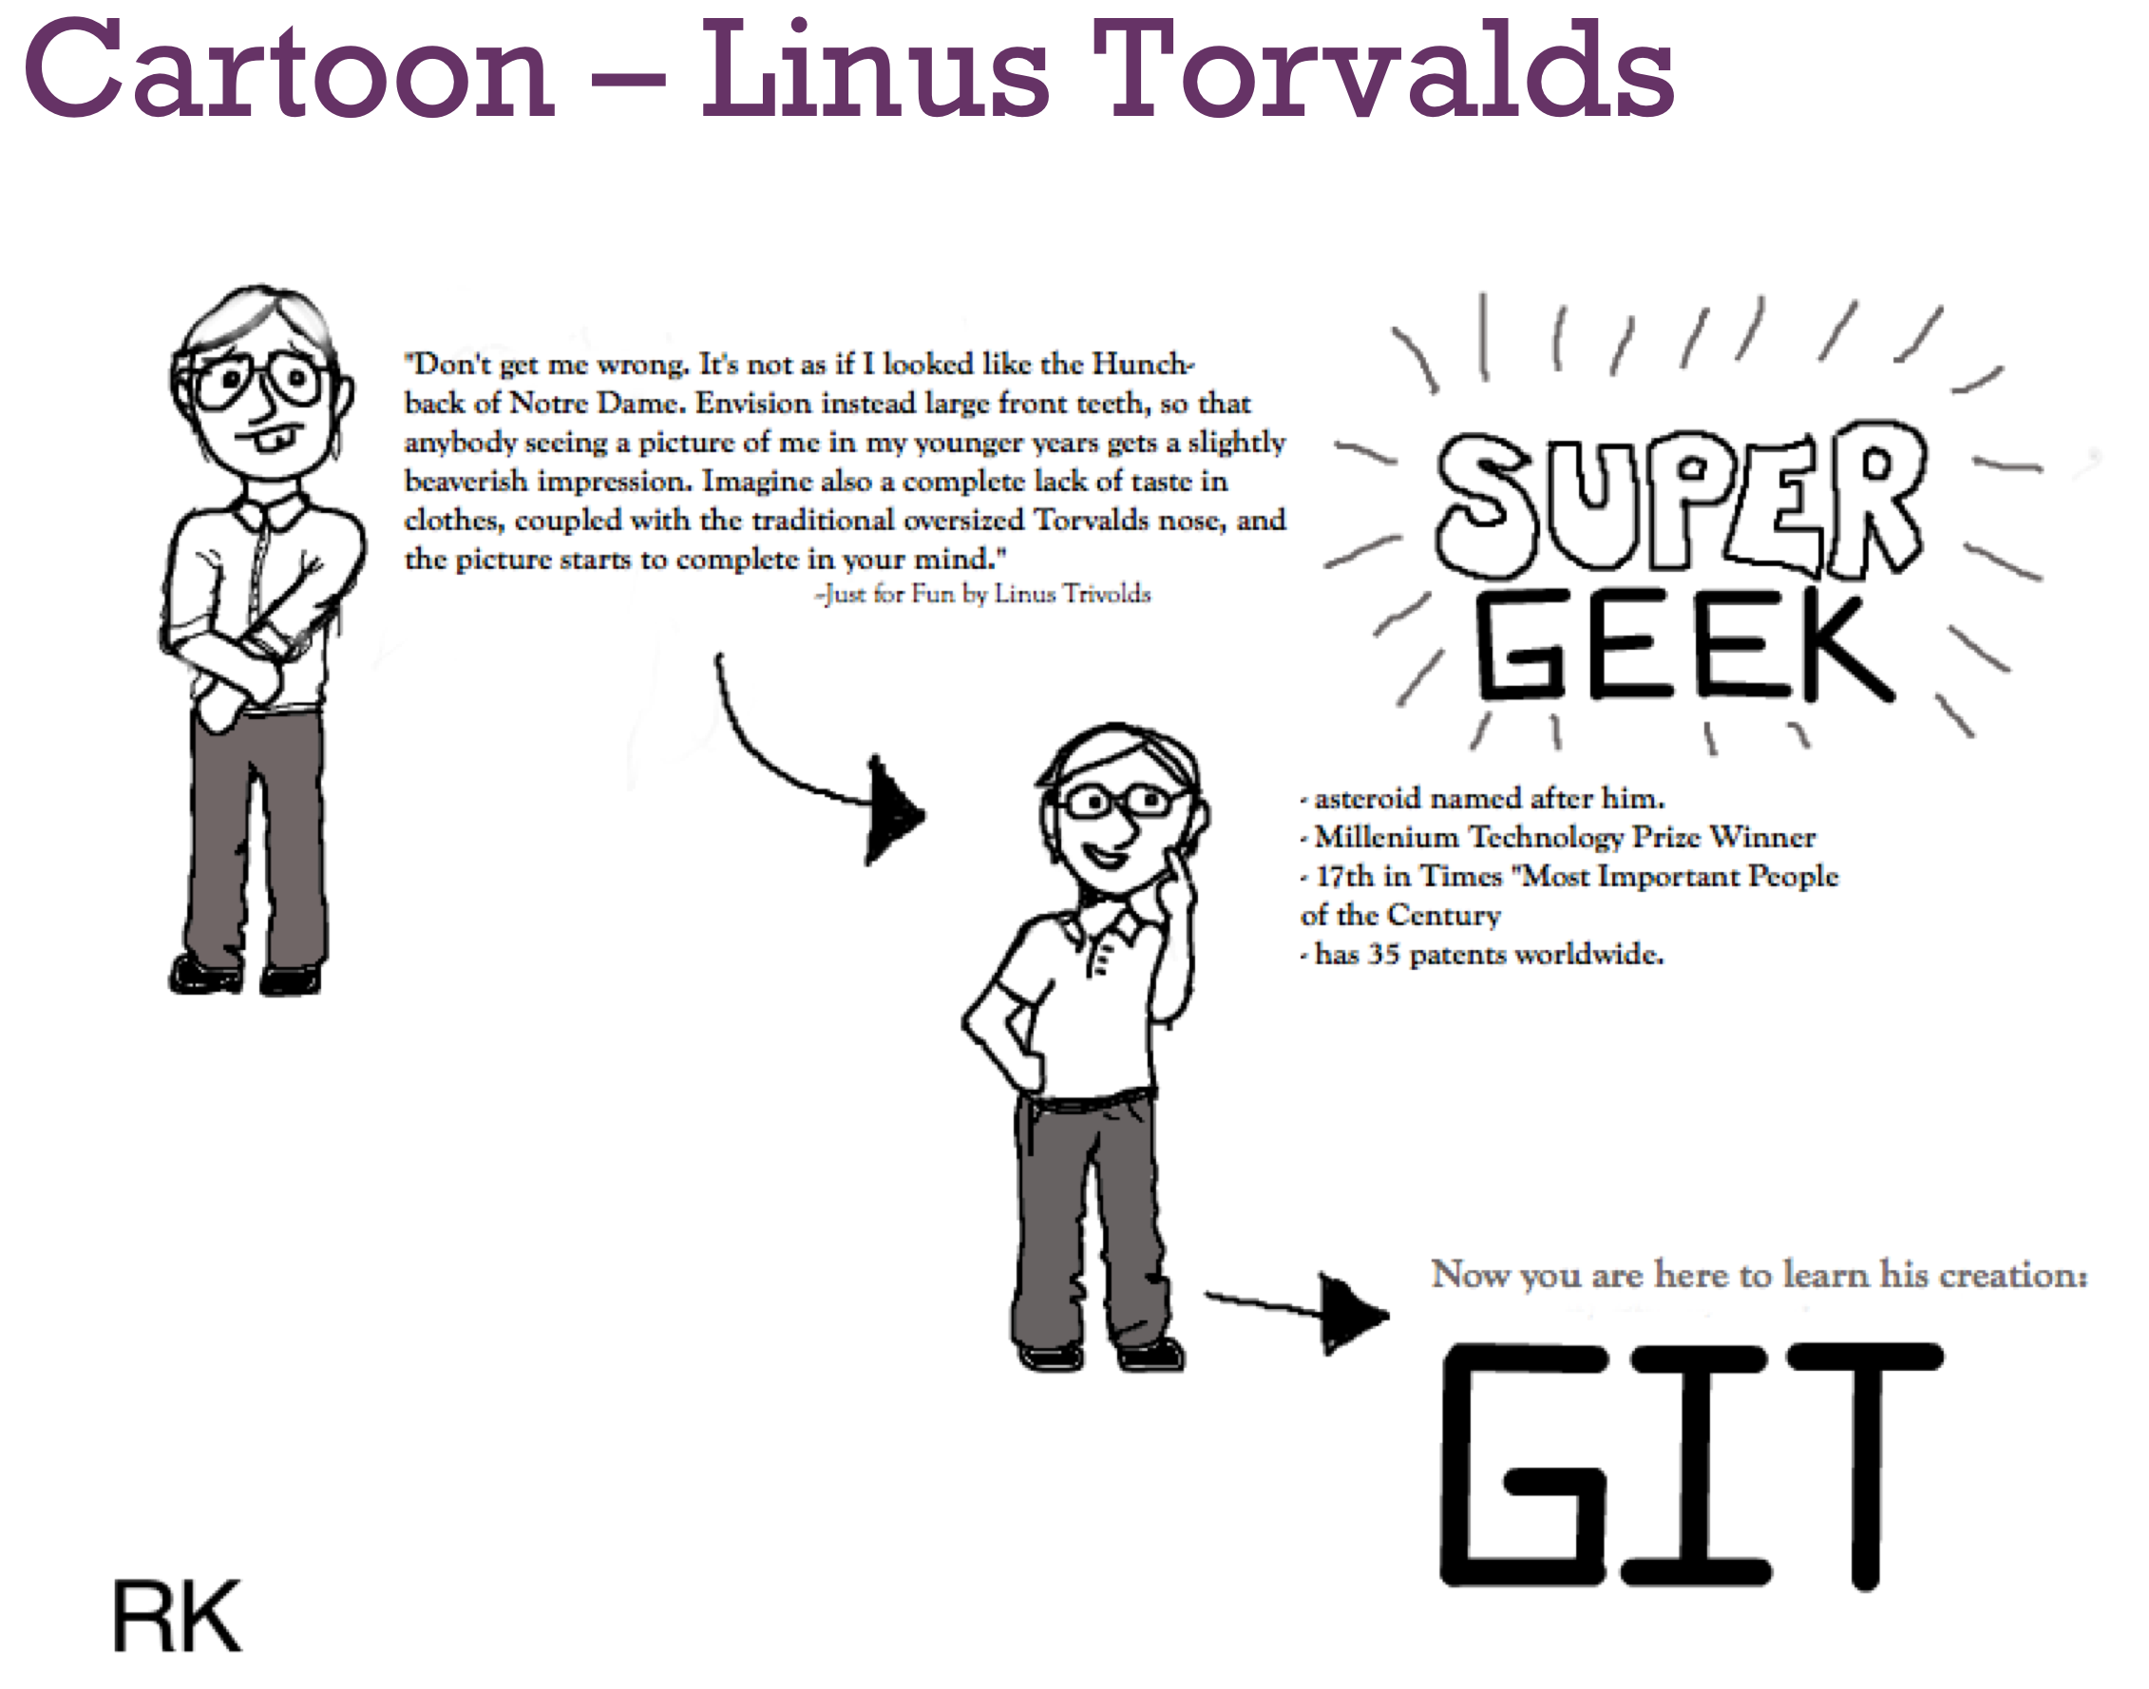
Cartoon – Linus Torvalds
Notes:
Instructor Notes: Instructor Notes are the same as Participant Notes.
Please present the Participant Notes.
Participant Notes:

Slide 10
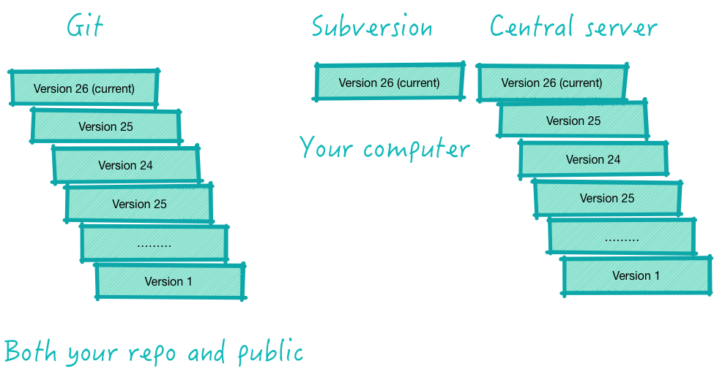
Git vs. Subversion
Notes:
Instructor Notes: Instructor Notes are the same as Participant Notes.
Please present the Participant Notes.
Participant Notes:
This picture illustrates the concept of cloning vs. checkout. In cloning (Git), each repository stores a complete history, with all versions. By contrast, in checkout (Subversion), the central server stores all repositories, while the developer's local repository contains only one version at a time, in its own separate directory.

Slide 11
Terminology
Key concepts:
Repository
Working copy
Index/Staging area
Blobs, Trees
Cloning
Remotes
Pulling + Pushing
Local history vs. Public history
Notes:
Instructor Notes: Instructor Notes are the same as Participant Notes.
Please present the Participant Notes.
Participant Notes:
We are going to review the terminology in subsequent slides.

Slide 12
How we will Approach the Terms
Define
Give examples
Hands-on
Notes:
Instructor Notes: Instructor Notes are the same as Participant Notes.
Please present the Participant Notes.
Participant Notes:
This describes our approach in subsequent slides.

Slide 13
Repository
A set of files and directories
Historical record of changes in the repository
A set of commit objects
A set of references to commit objects, called heads
Notes:
Instructor Notes: Instructor Notes are the same as Participant Notes.
Please present the Participant Notes.
Participant Notes:
The purpose of Git is to manage a project, or a set of files, as they change over time.
Git stores this information in a data structure called a repository.
A repository is simply a place where the history of your work is stored.
It often lives in a .git subdirectory of your working copy - a copy of the most recent state of the files you're working on.

Slide 14

Is it a Repository?
A copy of a project directory?
CVS?
Subversion?
Git?
Notes:
Instructor Notes: Explain why each choice qualifies as a repository, and why. If it does not, also explain the reason. Even a copy of a project directory can be considered a repository. But it will have very limited use for teamwork. Participant Notes: Git is a complete repository, where it is local or remote.

Slide 15
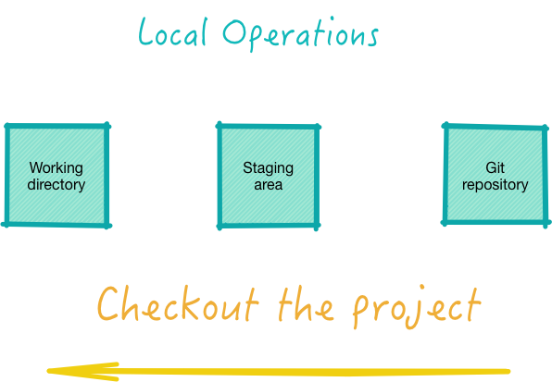
Working Copy
Aka “working directory,” is a single checkout of one version of the project.
"Index" and "Staging area" are synonyms
It is a simple file in the Git directory
Stores information about the next commit
It involved blobs and trees
Notes:
Instructor Notes: Instructor Notes are the same as Participant Notes.
Please present the Participant Notes.
Participant Notes:
A "local repository" is a copy of your project on your computer, together with some files generated by Git. In a local repository, there are three areas. The working directory are your files. "Staging area" is found in the .git directory. It is generated by Git and contains files ready to be put into Git. The "Git repository" area is also under the .get directory. It contains all files that are tracked by Git. A remote repository contains all of the same files, just that they are stored on a publicly-accessible server.

Slide 16
Lab 01- Install Git
Please do all steps in Lab 01:
git/lab01
Notes:
Instructor Notes:
Purpose:
Instruction Time Estimate:
Instructions:
Answer:
Follow-up/Debrief:

Slide 17

Try Put and Get Values (Minilab)
Put value, observe the key you get in return
$ echo 'test content' | git hash-object -w –stdin
Find the file back:
$ find .git/objects -type f
(SHA-1) - you will get back an SHA hash as a response
Get it back
git cat-file –p (SHA-1)
Notes:
Instructor Notes: Instructor Notes are the same as Participant Notes.
Please present the Participant Notes.
Participant Notes: Git is a key-value store. We never go to that low level, but here we just illustrate the concept for general information.

Slide 18
Lab 02
Please do all steps in lab 02:
git/lab02
Notes:
Instructor Notes:
Purpose:
Instruction Time Estimate:
Instructions:
Answer:
Follow-up/Debrief:

Slide 19

Cloning
Getting a copy of the existing get repository (quick, what is repository?)
How? git clone <url>
Example: $ git clone git://github.com/schacon/grit.git
Notes:
Instructor Notes: Instructor Notes are the same as Participant Notes.
Please present the Participant Notes.
Participant Notes: In cloning from a remote, you get all of the history of the project, with all of the versions, branches, and tags. All of that is copied from the remote to your local directory.
The purpose of Git is to manage a project, or a set of files, as they change over time.
Git stores this information in a data structure called a repository.
A git repository contains, among other things, the following: A set of commit objects.

Slide 20
Exercise
Instructions:
Clone on the command line
Clone in your preferred Git UI (i.e., Eclipse Git, SmartGit, etc.)
See the following lab:
Notes:
Instructor Notes:
Instructor to demonstrate these operations.
Participant Notes:

Slide 21
Lab 03
Please do all steps in lab 03:
git/lab03
Notes:
Instructor Notes:
Purpose:
Instruction Time Estimate:
Instructions:
Answer:
Follow-up/Debrief:

Slide 22
Cloning vs. Checkout
In Subversion, this would be checkout. Differences?
Notes:
Instructor Notes: Instructor Notes are the same as Participant Notes.
Please present the Participant Notes.
Participant Notes: Cloning copies the complete Git repository. This includes the history to the beginning of time, with all modifications. This is different from a checkout, where you get only one slice of the development history, namely, one version related to a certain point in time. git clone is to fetch your repositories from the remote git server.
git checkout is to checkout the desired status of your repository (like branches or particular files).

Slide 23

Remotes
Versions of your project that are hosted on the
Internet or network – that’s how you collaborate.
Remotes can be:
Multiple
Read only
Read-write
Notes:
Instructor Notes: Instructor Notes are the same as Participant Notes.
Please present the Participant Notes.
Participant Notes:
As you probably know, git is a distributed version control system.
Most operations are done locally. To communicate with the outside world,
git uses what are called remotes.
These are repositories other than the one on your local disk which you can push your changes into
(so that other people can see them) or pull from (so that you can get others changes)
A remote in Git is a common repository that all team members use to exchange their changes.
In most cases, such a remote repository is stored on a code hosting service like GitHub or on an internal server.

Slide 24
Try This - Quick Lab
git remote:
origin – This is where you clone your project from
Pulling + Pushing:
Pulling – from a branch on a remote
Fetching – all that you don’t have yet
Pushing – back to the branch on a remote
Notes:
Instructor Notes: Instructor Notes are the same as Participant Notes.
Please present the Participant Notes.
Participant Notes:
1. The git pull command is used to fetch and download
content from a remote repository and immediately update the local repository to match that content.
Merging remote upstream changes into your local repository is a common task in Git-based collaboration work flows.
2. Git Fetch:- In the simplest terms, git pull does a git fetchfollowed by a git merge.
You can do a git fetch at any time to update your remote-tracking branches under refs/remotes/<remote>/.
This operation never changes any of your own local branches under refs/heads,
and is safe to do without changing your working copy.
3. Git push:- Basically git commit "records changes to the repository" while git push "updates remote refs along with associated objects".
So the first one is used in connection with your local repository, while the latter one is used to interact with a remote repository.

Slide 25
Lab 04
Please do all steps in lab 04
git/lab04
Note, however, that the simplest way to work is to always use
git commit –a
Notes:
Instructor Notes:
Purpose:
Instruction Time Estimate:
Instructions:
Answer:
Follow-up/Debrief:

Slide 26

Local History vs. Public History
Local history is on your laptop.
You can:
Change commits
Change commit messages
Reorder
Squash
However, be careful pushing this to the public history because other developers may end up having to merge.
Notes:
Instructor Notes: Instructor Notes are the same as Participant Notes.
Please present the Participant Notes.
Participant Notes:
All of git history is stored on every participant’s computer. Thus, all developers are code guardians and custodians. However, care needs to be taken not to ruin everyone’s work.
This can happen when a developed messes up with the public history of the project.

Slide 27
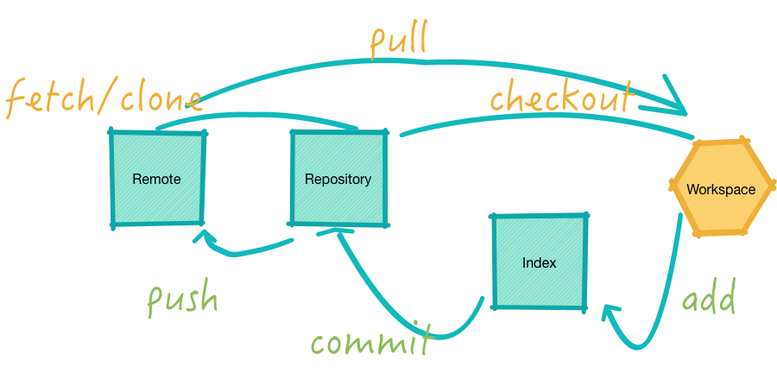
Basic Git Operations - Diagram
Here is the basic cycle of events in Git
Notes:
Instructor Notes: Walk through the basic operations on the diagram and explain them step by step.
Participant Notes:

Slide 28

Basic Git Operations
Viewing a commit in UI
Execute the commands below
In Git Bash
gitk
Or
Tools-Git Shell
gitk
To view a specific commit
git show 5809 (first few letters of the SHA-1)
Switching branches
git checkout <branch-name>
Notes:
Instructor Notes:
Instructor Notes are the same as Participant Notes.
Please present the Participant Notes.
Participant Notes:
Basic git operations are done on the command line. However, many developers prefer using graphical tools with UI. Both approaches are popular.

Slide 29
Try this

Slide 30

Switching Branches Use
Wearing many hats can be tough
Notes:
Instructor Notes: Instructor Notes are the same as Participant Notes.
Please present the Participant Notes.
Participant Notes:
You will use the "checkout" command to switch branches.
Checkout will update the files in your working tree to match the version stored in the branch that you wish to switch to.
You can take it as a way of switching between different workspace

Slide 31

A Day in Life of a Web Developer
Morning:
Do your work on a web site
Create a branch for a new story you’re working on
Do some work in that branch
Let us try that:
Work on the text file of your choice
Create a branch for a new story your-name_new
Do some work in that branch
Notes:
Instructor Notes:
Instructor Notes are the same as Participant Notes.
Please present the Participant Notes.
Participant Notes:
This scenario describes a typical day in the life of a developer. It then illustrates how the proper use of git can help alleviate this developer’s headache.

Slide 32
Afternoon
An emergency fix is required in your branch your-name!
Switch back to your production branch.
Create a branch to add the fix.
Test, merge the hotfix branch into your-name, and push to production.
Switch back to your original story and continue working.
Let's do that (following lab).
Notes:
Instructor Notes: Walk through the practical aspects of the work and how easy branch switching helps. Emphasize the best practice of creating short-lived branches.
Participant Notes:

Slide 33
Lab 05
Please do all steps in lab 05
git/lab05
Notes:
Instructor Notes:
Purpose:
Instruction Time Estimate:
Instructions:
Answer:
Follow-up/Debrief:

Slide 34
Changes, Staging, Committing

Slide 35

Changes, Staging, Committing
Staging a commit
Making a commit
Pushing your change
Undoing the latest local commit
Reverting a commit
Notes:
Instructor Notes: Instructor Notes are the same as Participant Notes.
Please present the Participant Notes.
Participant Notes:
Staging is a step before the commit process in git. That is, a commit in git is performed in two steps: staging and actual commit.
As long as a changeset is in the staging area, git allows you to edit it as you like (replace staged files with other versions of staged files,
remove changes from staging, etc.
2. Basically git commit "records changes to the repository" while git push "updates remote refs along with associated objects".
So the first one is used in connection with your local repository, while the latter one is used to interact with a remote repository

Slide 36

Staging a Commit
Review: What happens in staging?
Answer: Your changes go to the staging area.
Do commands:
git status
git add <file>
git commit –a *Interactive
git add -i
Notes:
Instructor Notes: Instructor Notes are the same as Participant Notes.
Please present the Participant Notes.
Participant Notes:
To stage a file is simply to prepare it finely for a commit.
Git, with its index allows you to commit only certain parts of the changes you've done since the last commit.
Say you're working on two features - one is finished, and one still needs some work done.
You'd like to make a commit and go home (5 o'clock, finally!) but wouldn't like to commit the parts of the second feature, which is not done yet.
You stage the parts you know belong to the first feature, and commit. Now your commit is your project with the first feature done,
while the second is still in work-in-progress in your working directory.

Slide 37
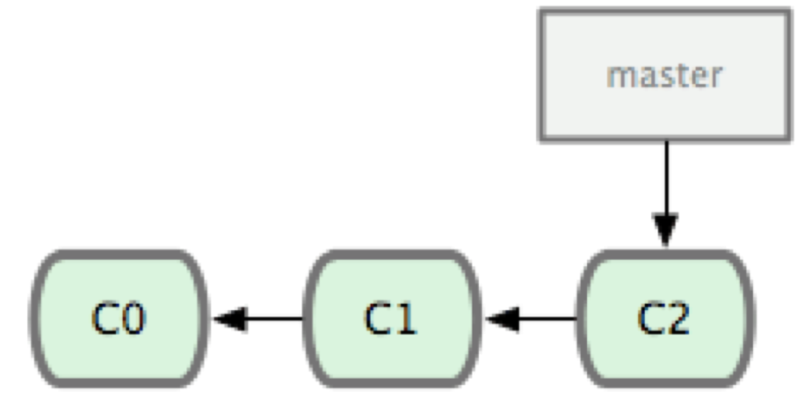
Making a Commit
Commit is a record of your changes in a Git directory (repository).
Making a commit is moving the branch point (master in this case) to the next snapshot.
Notes:
Instructor Notes:
Instructor Notes are the same as Participant Notes.
Please present the Participant Notes.
Participant Notes:
This is a normal situation: “master” is simply a label. At the moment, it is pointing to the latest snapshot.

Slide 38

Commits
What are the differences and similarities between a commitment and a commit?
Notes:
Instructor Notes: Instructor Notes are the same as Participant Notes.
Please present the Participant Notes.
Participant Notes:
git commit. The "commit" command is used to save your changes to the local repository. ... Also note that in Git (not like in Subversion), a commit is not automatically transferred to the remote server. Using the "git commit" command only saves a new commit object in the local Git repository.

Slide 39
Commit Features
Performance
Impermanence
Commit leaves a record
Commit goes into the Git area
Commit can be further recorded in a remote
Commits can be taken back (undone locally or reverted)
Commits can be erased (rebase)
Notes:
Instructor Notes:
Instructor Notes are the same as Participant Notes.
Please present the Participant Notes.
Participant Notes:
These are the properties of the commit as a git functionality feature.

Slide 40

How do Branching and Merging Work?
Let’s go back to our morning-afternoon scenario.
In brief…
Working on your issue:
Get interrupted with the production fix
Fix the production, go back to your issue
Notes:
Instructor Notes: Instructor Notes are the same as Participant Notes.
Please present the Participant Notes.
Participant Notes:
Git branch
A branch represents an independent line of development. Branches serve as an abstraction for the edit/stage/commit process.
You can think of them as a way to request a brand new working directory, staging area, and project history.
New commits are recorded in the history for the current branch, which results in a fork in the history of the project.
The git branch command lets you create, list, rename, and delete branches. It doesn’t let you switch between branches or put a forked history back together again.
For this reason, git branch is tightly integrated with the git checkout and git merge commands.
Git Merge
Git merge will combine multiple sequences of commits into one unified history. In the most frequent use cases, git merge is used to combine two branches. The following examples in this document will focus on this branch merging pattern. In these scenarios, git merge takes two commit pointers, usually the branch tips, and will find a common base commit between them. Once Git finds a common base commit it will create a new "merge commit" that combines the changes of each queued merge commit sequence.

Slide 41
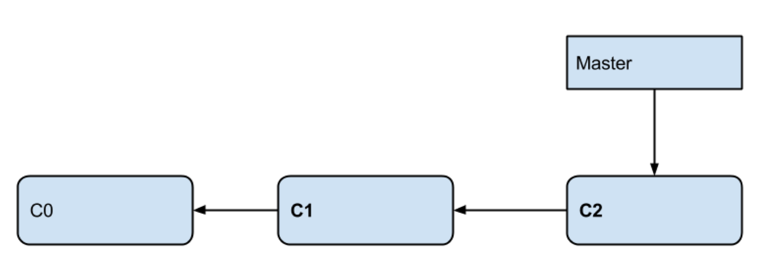
This is Where You Start
Notes:
Instructor Notes:
Instructor Notes are the same as Participant Notes.
Please present the Participant Notes.
Participant Notes:
At the beginning, ‘master’ is a label pointing at the latest snapshot, C2.

Slide 42
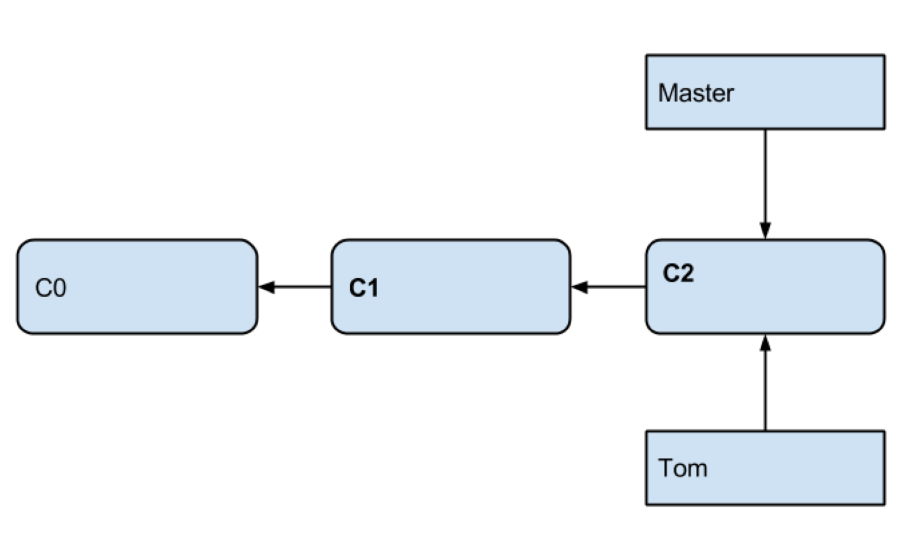
Prepare to Work on Your Feature
Notes:
Instructor Notes:
Instructor Notes are the same as Participant Notes.
Please present the Participant Notes.
Participant Notes:
Tom is another label, and currently it is pointing at the same snapshot as the ‘master’ label.

Slide 43
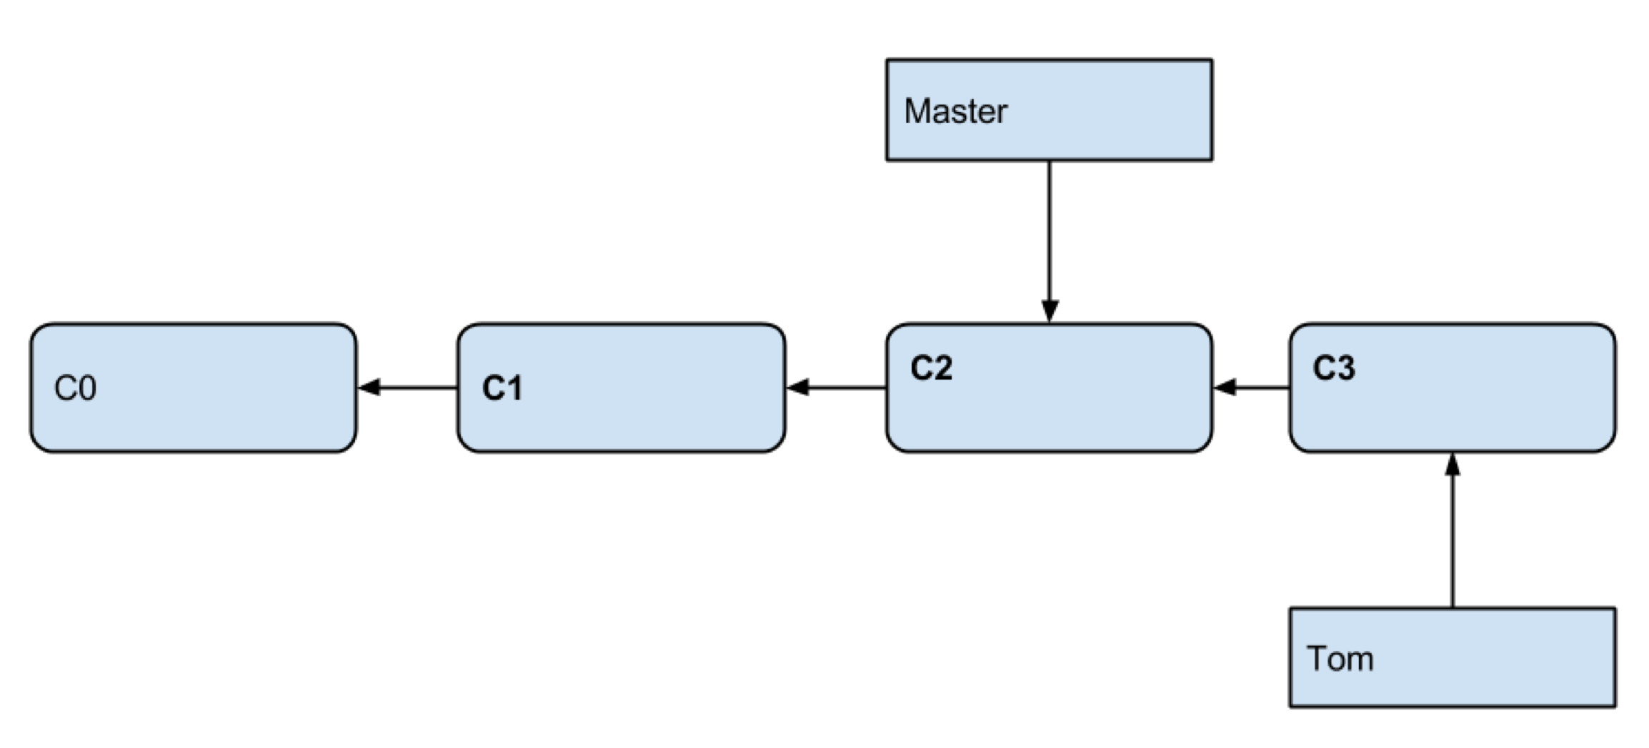
Commit Your New Changes
Notes:
Instructor Notes:
Instructor Notes are the same as Participant Notes.
Please present the Participant Notes.
Participant Notes:
Tom went ahead with his work. He is pointing to the latest snapshot while the ’master’ did not change.

Slide 44
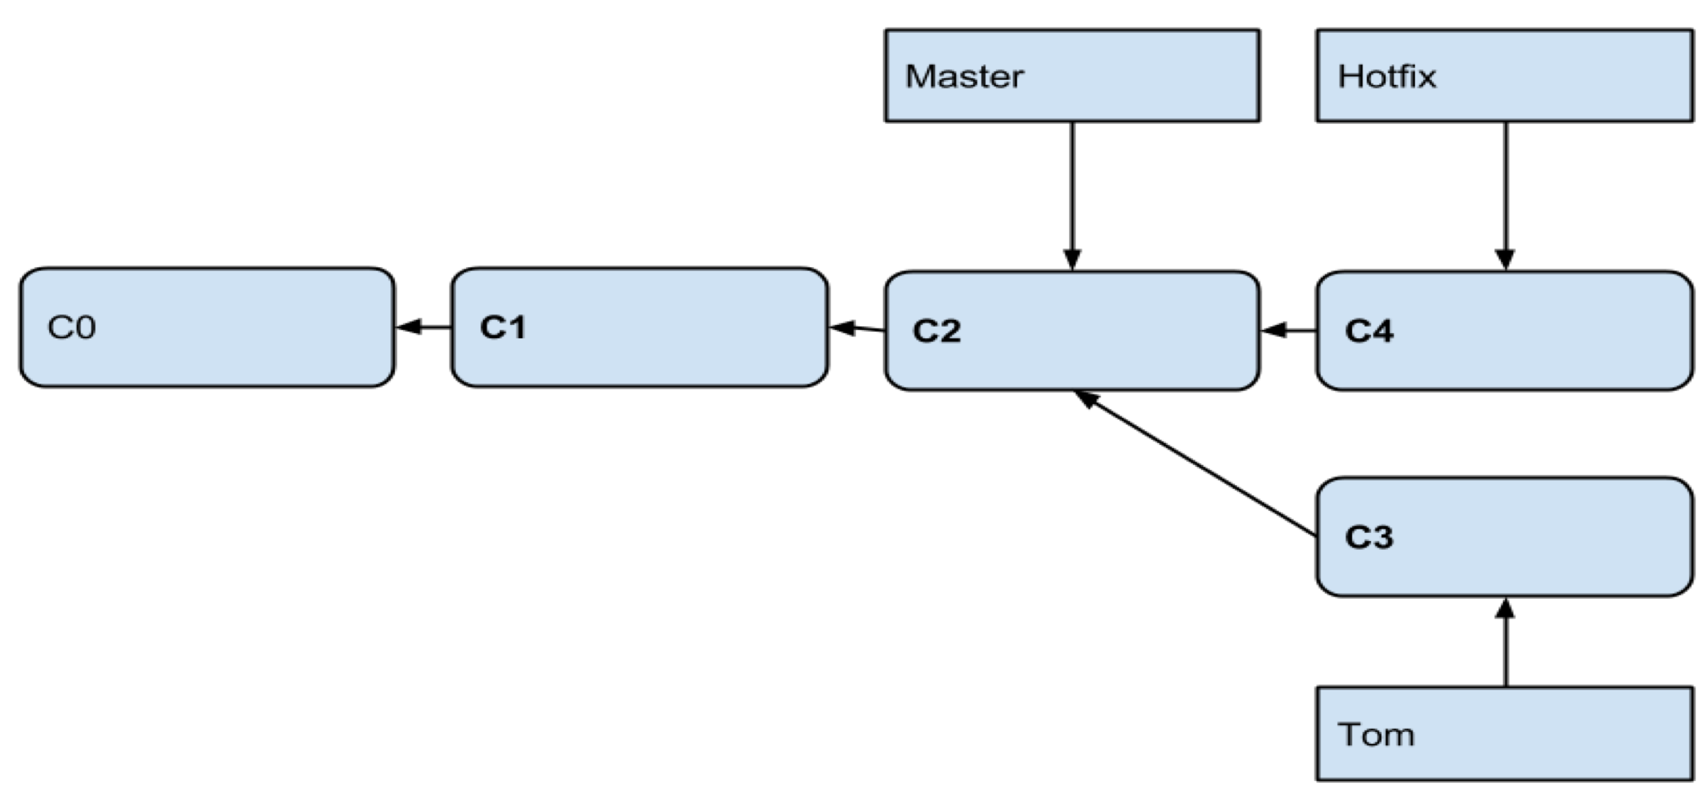
Work on the Hotfix
Notes:
Instructor Notes:
Instructor Notes are the same as Participant Notes.
Please present the Participant Notes.
Participant Notes:
Now, both ‘Tom’ and ‘Hotfix’ are branches, that is, labels pointing at snapshots. However, ‘Hotfix’ is pointing at a later snapshot than ’Tom.’ Git knows about it.

Slide 45
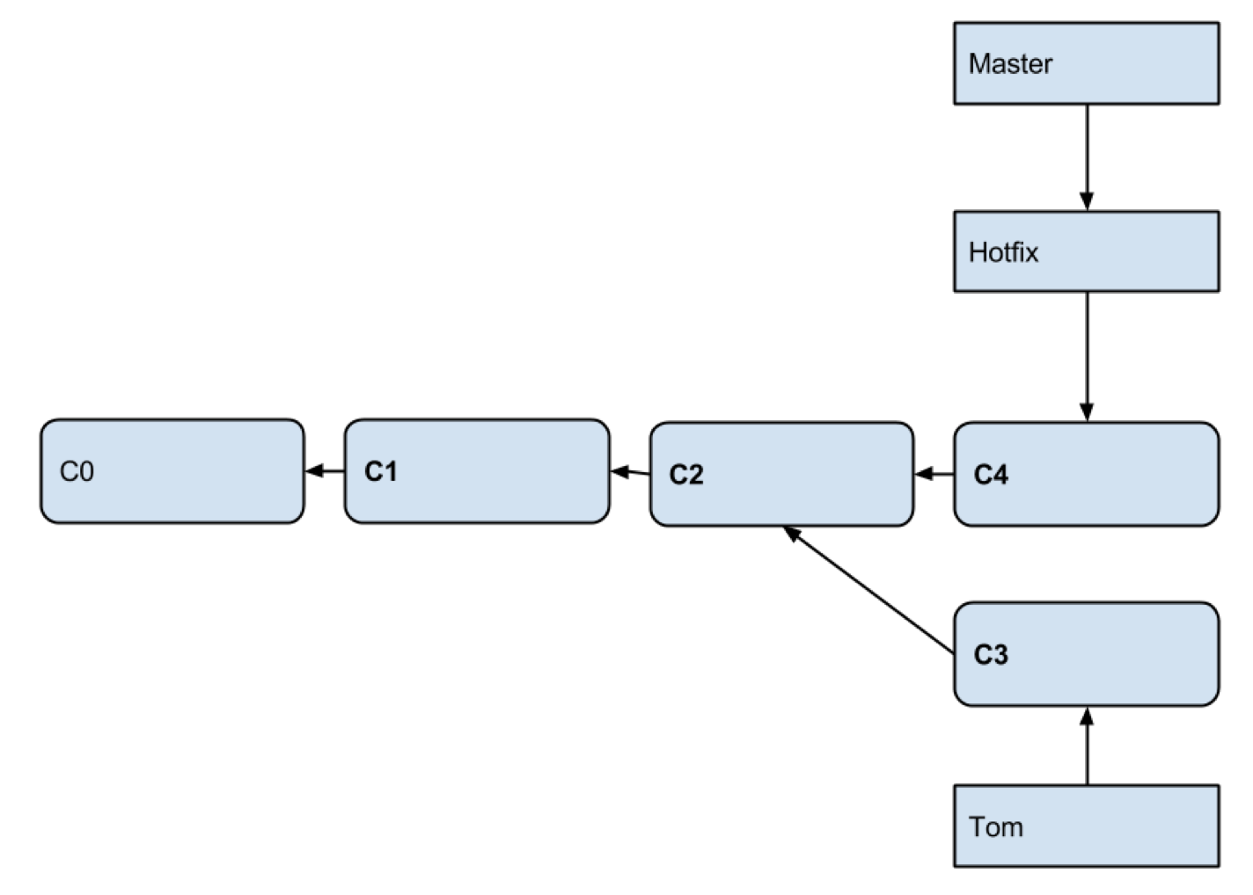
Merge Hotfix
Notes:
Instructor Notes:
Instructor Notes are the same as Participant Notes.
Please present the Participant Notes.
Participant Notes:
This is the result of a merge operation. Now, ‘Master” and ‘Hotfix’ are pointing to the same snapshot.

Slide 46
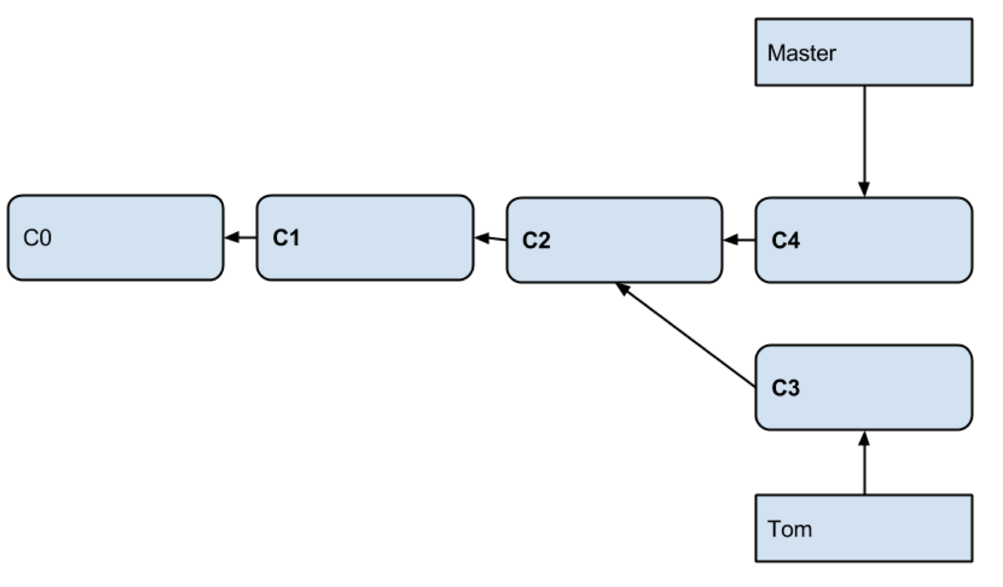
And Now, Clean Up!
Notes:
Instructor Notes:
Instructor Notes are the same as Participant Notes.
Please present the Participant Notes.
Participant Notes:
And, since Master and Hotfix were pointing to the same C4, you can delete branch ‘Hotfix’ as unneeded.

Slide 47
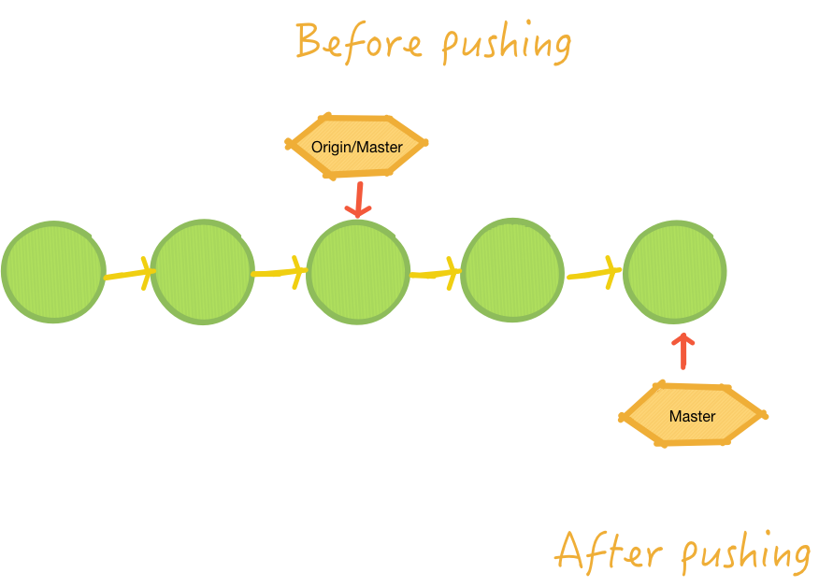
Pushing Your Changes
Notes:
Instructor Notes:
Instructor Notes are the same as Participant Notes.
Please present the Participant Notes.
Participant Notes:
This picture illustrates the effect of pushing to the public repository. Push, is just a moving of the branch label.

Slide 48

Pushing – Do Not Use Force!
As a good practice, do not do this:
git push <remote> --force
When can it happen?
Did not pull but want to push
Rebase (we will mention it later)
Notes:
Instructor Notes: Instructor Notes are the same as Participant Notes.
Please present the Participant Notes.
Participant Notes:
Pushing – Do Not Use Force
Be aware that force-pushing is a highly dangerous and unclean solution when you’re working in a shared repository.
All commits in the shared repository should be considered immutable. To keep your repository consistent and keep your coworkers happy, you should use git revertinstead.
If you made some mistake and you haven’t pushed the changes to remote repository, you can use tools such as git commit --amend, rebase, reset and others.
But once you’ve pushed your changes, you cannot change your git history without force-pushing.
Let’s assume you know what you’re doing and want to change the history of your git repository.
As an example, say you pushed some sensitive data that belong nowhere near your repository. How to remove it?
Beware, all sensitive data that you have pushed to the remote repository should be considered compromised
Finally, Use force push only as a last resort when everything else fails. Things might get ugly for you and for your repository

Slide 49

Undoing Latest Local Commit
Can you do this?
git undo-commit
Yes, if prior you type
git config --global alias.undo-commit 'reset --soft HEAD^'
Another way:
git reset --soft HEAD~1
Notes:
Instructor Notes: Instructor Notes are the same as Participant Notes.
Please present the Participant Notes.
Participant Notes:
First, before we bring the big guns in, let's make sure you really need them. Because in case you just want to edit your last commit,
you can simply use Git's amend feature. It allows you to correct the last commit's message as well as add more changes to it.
If that's what you want to do, Undoing the Last Commit
However, of course, there a tons of situations where you really want to undo that last commit. E.g. because you'd like to restructure it extensively - or even discard it altogether!
In these cases, the "reset" command is your best friend:
$git reset --soft HEAD~1
Reset will rewind your current HEAD branch to the specified revision. In our example above, we'd like to return to the one before the current revision - effectively making our last commit undone.
Note the --soft flag: this makes sure that the changes in undone revisions are preserved. After running the command, you'll find the changes as uncommitted local modifications in your working copy.
If you don't want to keep these changes, simply use the --hard flag. Be sure to only do this when you're sure you don't need these changes anymore.
$ git reset --hard HEAD~1

Slide 50

Undo Staging
Say you did this and added too much
git add .
Here is how you can extricate yourself
git rm -r --cached .
In the future, you may do ‘add’ interactively
git add -n .
Try this: create a file, add it, then undo the staging
Notes:
Instructor Notes: Instructor Notes are the same as Participant Notes.
Please present the Participant Notes.
Participant Notes:
Undo a git add - remove files staged for a git commit. Will remove a file named filename.txt from the current index, the "about to be committed" area, without changing anything else. To undo git add . use git reset (no dot)

Slide 51

Revert Commit
To go to a previous commit
git checkout 0d1d (start of your hash)
Careful! To go back and delete all subsequent commits
git reset --hard 0d1d (start of the commit hash)
Notes:
Instructor Notes: Instructor Notes are the same as Participant Notes.
Please present the Participant Notes.
Participant Notes:
The git revert command is a forward-moving undo operation that offers a safe method of undoing changes.
Instead of deleting or orphaning commits in the commit history, a revert will create a new commit that inverses the changes specified.
Git revert is a safer alternative to git reset in regards to losing work.

Slide 52
Merge and Conflict Resolution

Slide 53
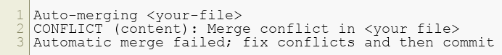
How Merge Conflicts Happen
Change a file in one branch
Chart the same file in another branch – same line!
Now, merge one branch into the other
git checkout branch1 –b – now edit the file
git checkout branch2 –b – now edit the file
git merge branch1
You get:
Notes:
Instructor Notes: Instructor Notes are the same as Participant Notes.
Please present the Participant Notes.
Participant Notes:
Merge conflicts. Sometimes you get merge conflicts when merging or pulling from a branch. Git will then tell you something like CONFLICT (content):Merge conflict in Fakefile. It also tells you to fix the conflicts and then to commit the result
Conflicts occur when the same file was changed in contradictory ways. Most modifications don't fall into this category:
if two people just work on the same file, Git can most likely figure things out on its own. The most common situation when it cannot do this is when the exact same lines were edited in that file. In that case, Git has no way of knowing what's correct - you'll have to look at the changes and decide how you want the file to finally look.

Slide 54

How to Resolve a Merge Conflict
Git writes markers in the file
You edit that file
git add <file>
Notes:
Instructor Notes: Instructor Notes are the same as Participant Notes.
Please present the Participant Notes.
Participant Notes:
When faced with a merge conflict, the first step is to understand what happened. E.g.: Did one of your colleagues edit the same file on the same lines as you? Did he delete a file that you modified? Did you both add a file with the same name? Git will tell you that you have "unmerged paths" (which is just another way of telling you that you have one or more conflicts) via "git status“
The contents after the first marker originate from your current working branch. After the angle brackets, Git tells us where (from which branch) the changes came from. A line with "=======" separates the two conflicting changes.
Our job is now to clean up these lines: when we're done, the file should look exactly as we want it to look.
It can be necessary to consult the teammate who wrote the conflicting changes to decide which code is finally correct.
Maybe it's yours, maybe it's his - or maybe a mixture between the two.
Opening the raw file in your editor and cleaning it up there is perfectly valid, but not very comfortable.
Using a dedicated merge tool can make this job a great deal easier (if you have one installed...).
You can configure your tool of choice using the "git config" command. Consult your tool's documentation for detailed instructions. Then, in case of a conflict, you can later invoke it by simply typing "git mergetool".

Slide 55
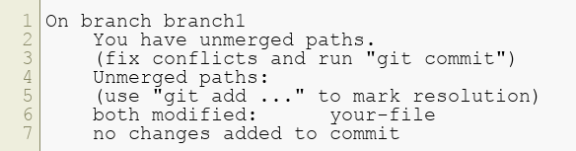
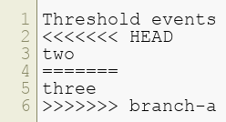
Conflict Message Example
git status
What you will see:
Notes:
Instructor Notes:
Instructor Notes are the same as Participant Notes.
Please present the Participant Notes.
Participant Notes:
This is an example of a message you will see when two people edited the same line and git cannot decide which commit is right.

Slide 56
Lab 06
*Please do all steps in lab 06
git/lab06
Notes:
Instructor Notes:
Purpose:
Instruction Time Estimate:
Instructions:
Answer:
Follow-up/Debrief:

Slide 57
Preventing Merge Conflicts
Simple
Advanced
Go with small iterations, in a branch, then merge and delete that branch
Do not forget to pull often
git pull rebase
Git will:
Undo (unwind your commits)
Pull remote commits
Replay your local commits
You fix the conflicts if any:
git rebase continue
Notes:
Instructor Notes: Instructor Notes are the same as Participant Notes.
Please present the Participant Notes.
Participant Notes:
Keep your changes small.
Rebase with your main branch (generally master) when it changes.
Review pull requests faster and merge them to the main branch.

Slide 58

Tagging
tags - symbolic names for a given revision.
They always point to the same object (usually: to the same revision); they do not change.
branches - symbolic names for line of development.
New commits are created on top of branch. The branch pointer naturally advances, pointing to newer and newer commits.
Notes:
Instructor Notes: Instructor Notes are the same as Participant Notes.
Please present the Participant Notes.
Participant Notes:
Tagging is done with git tag, and the tags that are created using git tag are the base for the commit identifiers git describe creates. In another words, in Git you don't tag branches. You are tagging commits. It is correct to say that tag is just an annotated pointer to a commit.

Slide 59

Pull Requests
Git has no branch security.
Anyone can work in his friend’s branch, then commit.
How do you add not-trusted developers to the team?
New developers may be given read-only access.
They will fork the project but won’t be able to commit the changes.
They then issues a git pull request
Notes:
Instructor Notes: Instructor Notes are the same as Participant Notes.
Please present the Participant Notes.
Participant Notes:
Pull requests let you tell others about changes you've pushed to a GitHubrepository. Once a pull request is sent, interested parties can review the set of changes, discuss potential modifications, and even push follow-up commits if necessary.

Slide 60
Lab 07
Please do all steps in lab 07
git/lab07
## Thank you
Notes:
Instructor Notes:
Purpose:
Instruction Time Estimate:
Instructions:
Answer:
Follow-up/Debrief:

Slide 61
Discussion: Placeholder
Placeholder for quiz question
Notes:
Instructor Notes:
Purpose:
Instruction Time Estimate:
Instructions:
Answer:
Follow-up/Debrief:

Slide 62
Discussion: Placeholder
Placeholder for quiz question
Notes:
Instructor Notes:
Purpose:
Instruction Time Estimate:
Instructions:
Answer:
Follow-up/Debrief:

